Slide 1

Password Security Testing using John the Ripper Hashed password cracking tool

Slide 2
Objective
The purpose of this project is to understand the real-world implications of weak password security by using John the Ripper, an industry-standard open-source password cracking tool. Students will simulate password attacks in a controlled lab environment to:
Learn ethical password auditing techniques.
Understand how attackers exploit weak credentials.
Gain hands-on experience with password hashing and cracking mechanisms.
Analyze and recommend stronger password policies.

Slide 3
Problem Statement
Passwords remain the most common form of user authentication. However, weak passwords, reused credentials, and poor storage practices make systems vulnerable to cyber attacks. Organizations often do not test their password strength policies or detect vulnerable hashes. This project addresses the need to ethically audit and improve password security in IT environments.

Slide 4
Introduction
John the Ripper (JtR) is a popular open-source password-cracking tool used by security professionals to test and improve password strength. It supports a wide range of hashing algorithms and can perform fast dictionary, brute-force, and hybrid attacks. Widely used in penetration testing and digital forensics, John the Ripper helps identify weak passwords and enhance overall security posture.

Slide 5

Introduction
Tool: John the Ripper is a password cracking tool.
Users: Used by security professionals.
Algorithms: Supports multiple algorithms and attack methods.
Methods: Includes brute force and rainbow table attacks.
Customization: Allows complex cracking with rules and wordlists.

Slide 6
Project Scope
In Scope:
- Use of John the Ripper in a virtual lab to crack sample password hashes.
- Cracking techniques: dictionary attack, brute-force, hybrid.
- Identifying weak vs. strong password policies.
- Report generation and mitigation recommendations.
Out of Scope:
- Attacking real user data or unauthorized systems.
- Use in non-lab or unethical environments.

Slide 7
Tools/Technologies Required
John the Ripper (Community/Pro edition)
Kali Linux or Ubuntu VM
Sample password hash files (SHA1, MD5, DES)
Wordlists (e.g., rockyou.txt)
VirtualBox / VMware / Cloud Lab

Slide 8
Reasons to use John The Ripper
Supports Unix, Windows, and Kerberos.
Compatible with LDAP, MySQL, and MD4 via extra modules.
Widely used password cracking tool.
Preferred choice for penetration testers.
Available on multiple platforms.
Automatically detects password hash types.
Can crack multi-encrypted password formats.

Slide 9
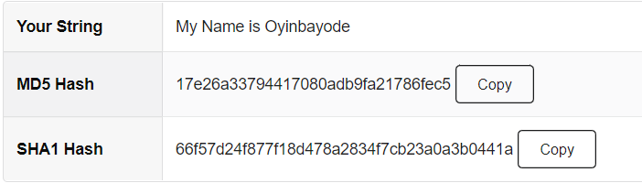
Understanding Hashed Password
Hashed password: a transformed version of a plain text password.
Hash functions convert passwords into hashes.
Password hashes are stored on servers instead of plain text.
Hashing enhances password storage security.
Despite hashing, passwords can still be cracked.

Slide 10
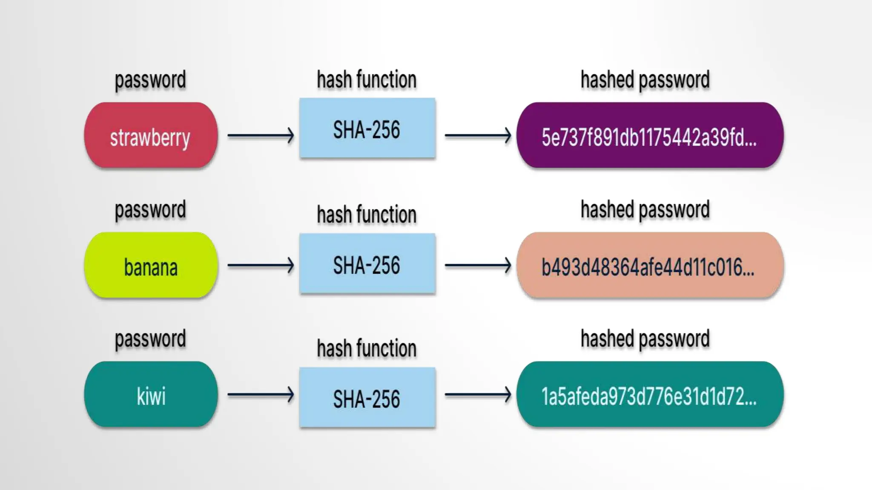
Understanding Hashed Password

Slide 11
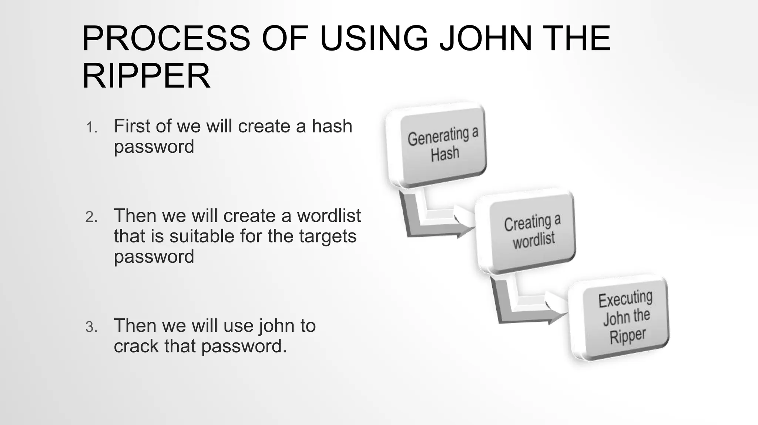
Process of Execution

Slide 12
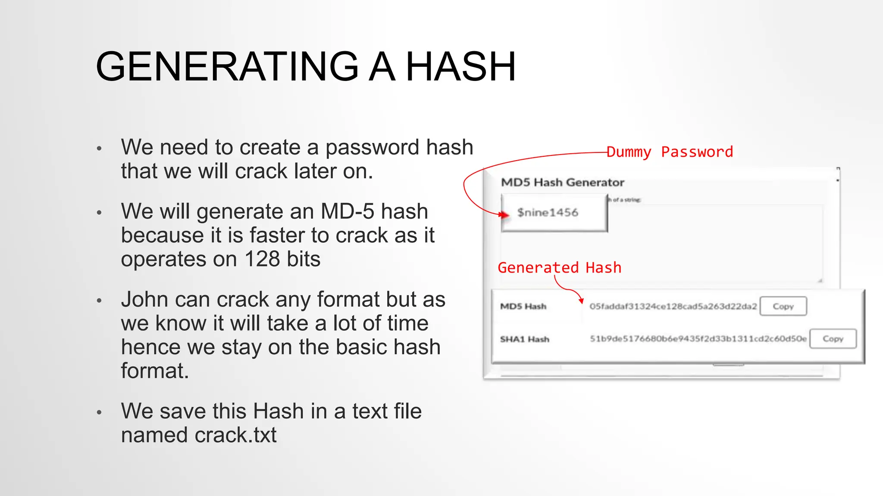
Generating a Hash

Slide 13
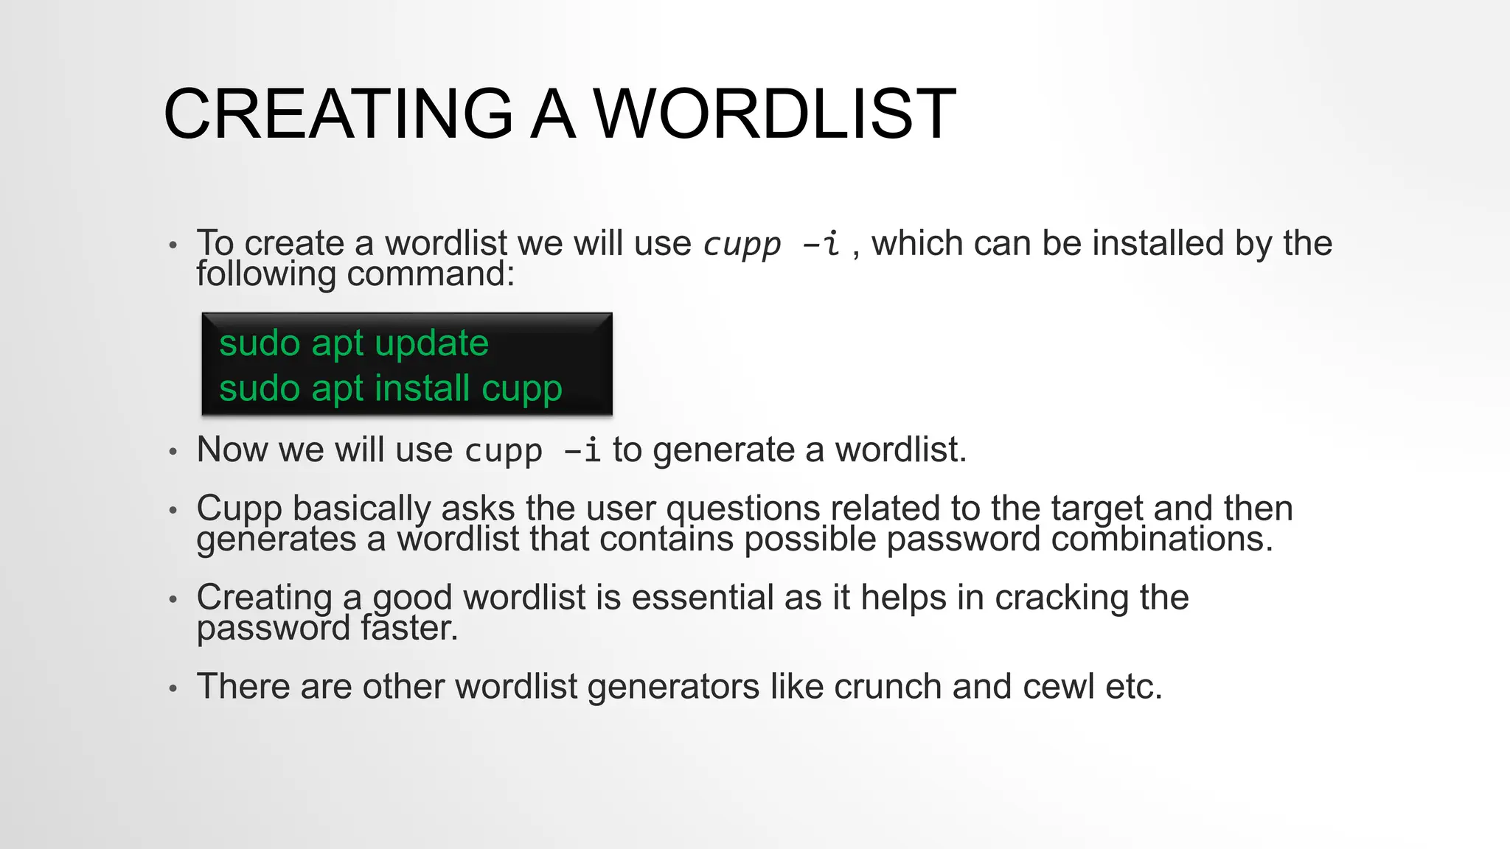
Creating a Wordlist

Slide 14
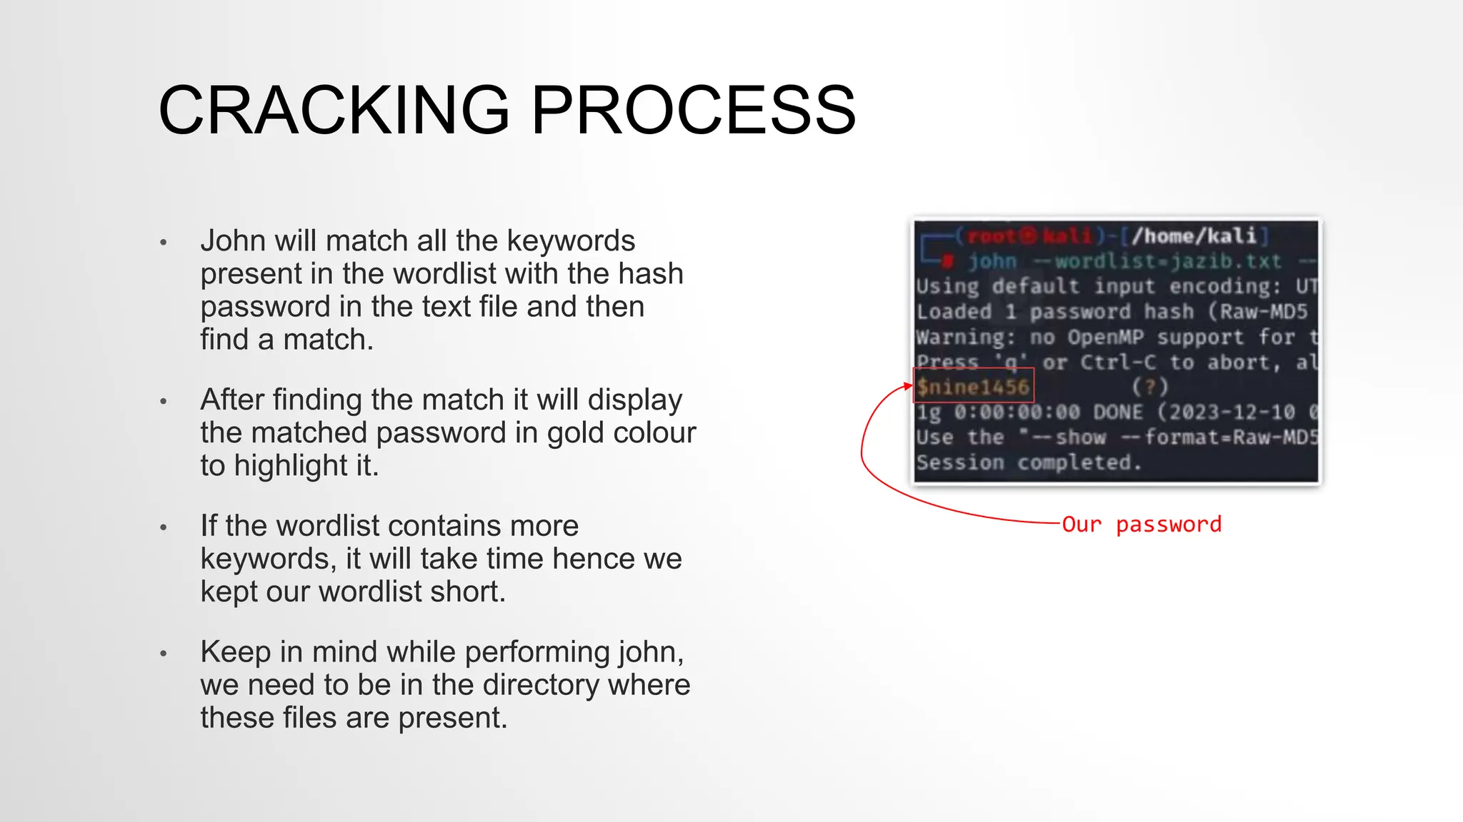
Cracking Process

Slide 15
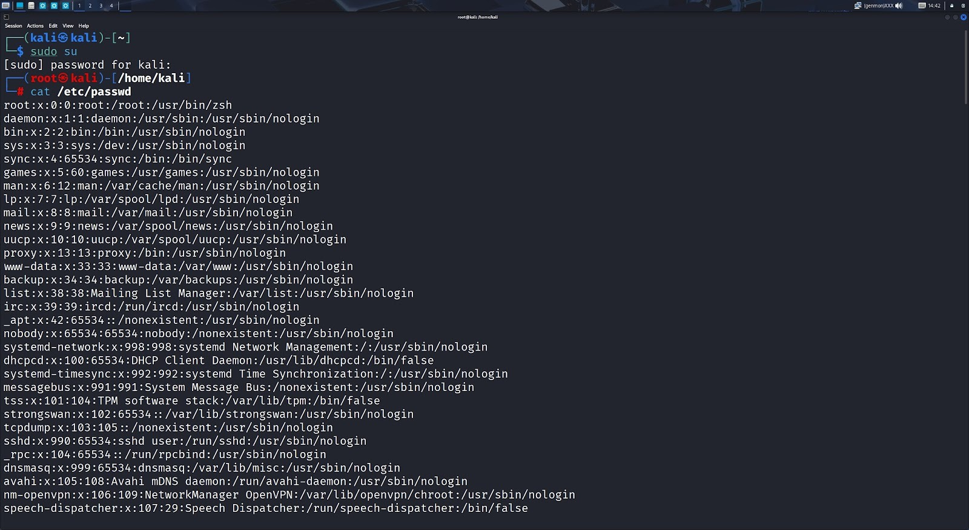
Execution → Open Kali linux and run it in the Root user. → Use cat/etc/passwd command to display the contents of the all user accounts registered on the system.

Slide 16
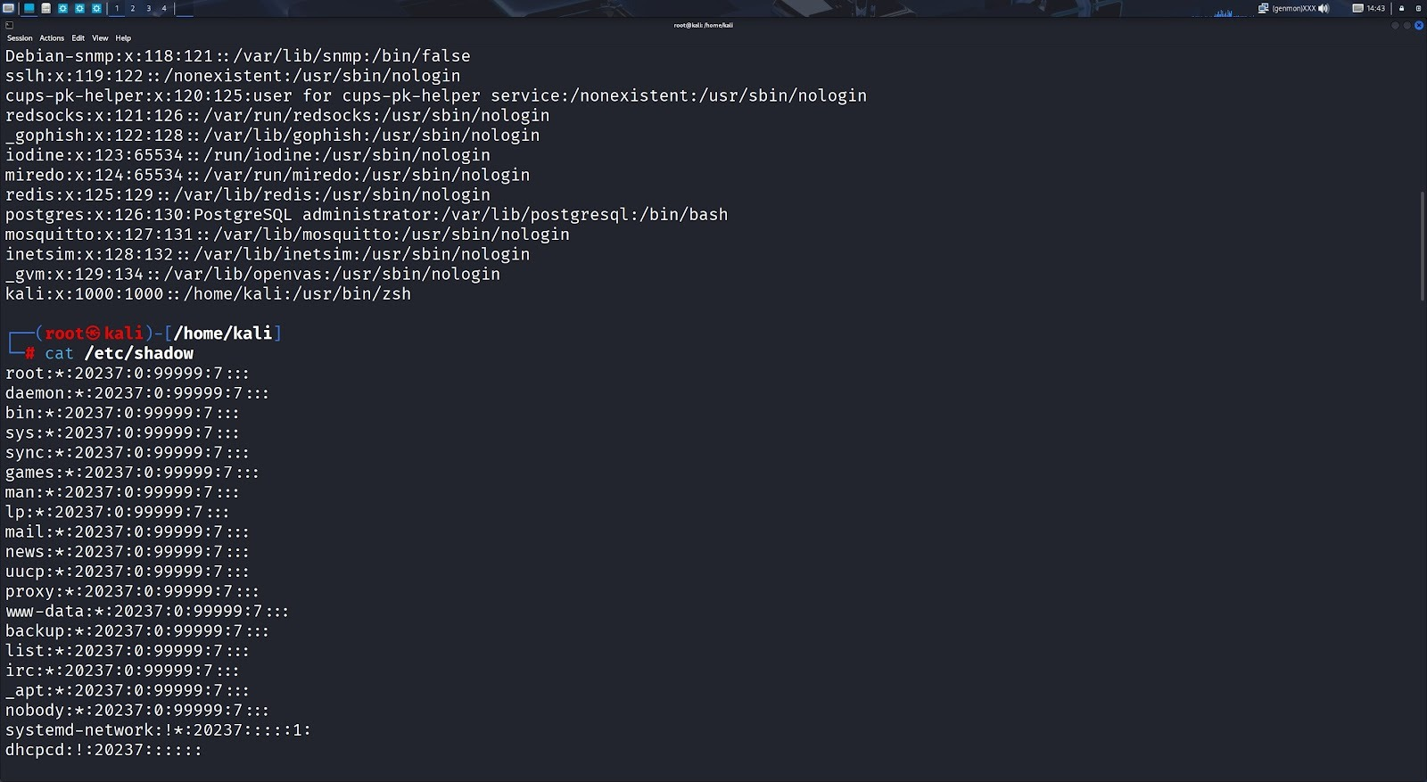
Execution → Use cat/etc/shadow command in Linux to display the contents of the shadow password file, which stores encrypted user passwords and other sensitive account information.

Slide 17
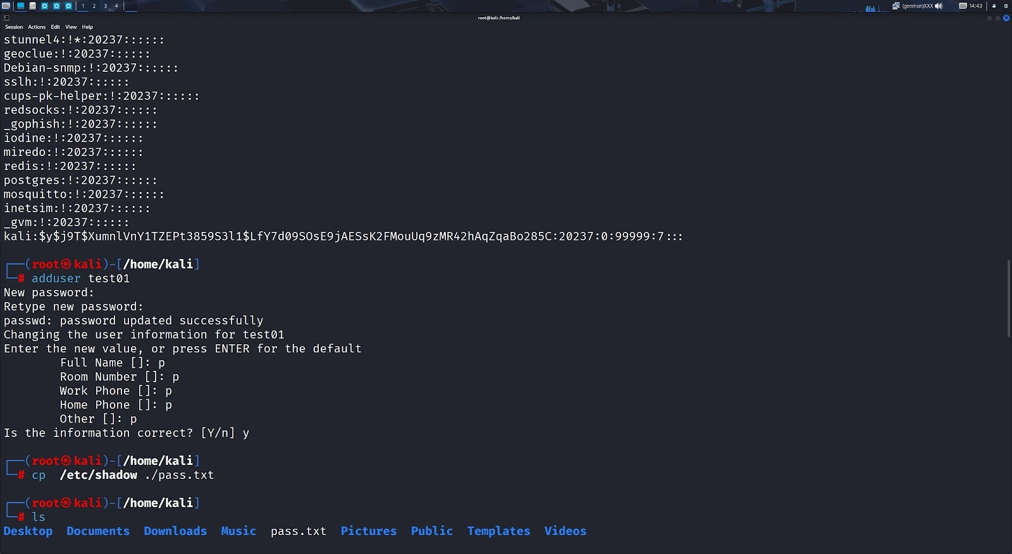
Execution → Use adduser test01 command to Create a user and give a password to it. → I have created the user with name of test01 and its password is bunny. → And now give cp/etc/shadow ./pass.txt command , to copy the contents of shadow passwords file to a new file named pass.txt in the current directory.

Slide 18
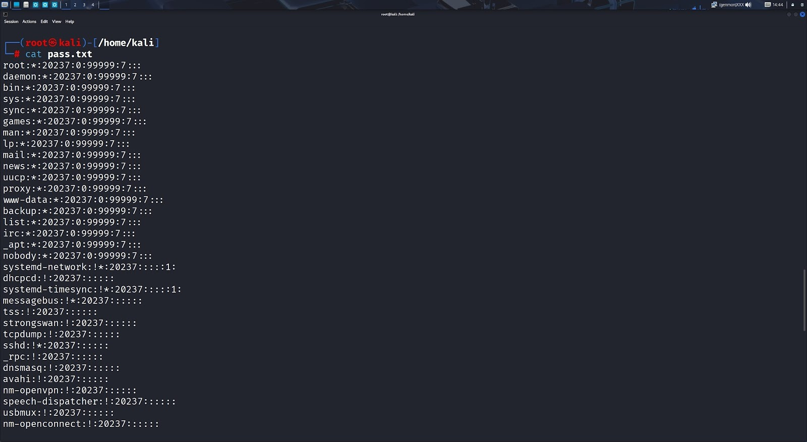
Execution → Now give cat pass.txt command to view all the content in that file. → Now delete all the content in the pass.txt file except test01 user credentials. by using nano pass.txt command you can edit the file.

Slide 19
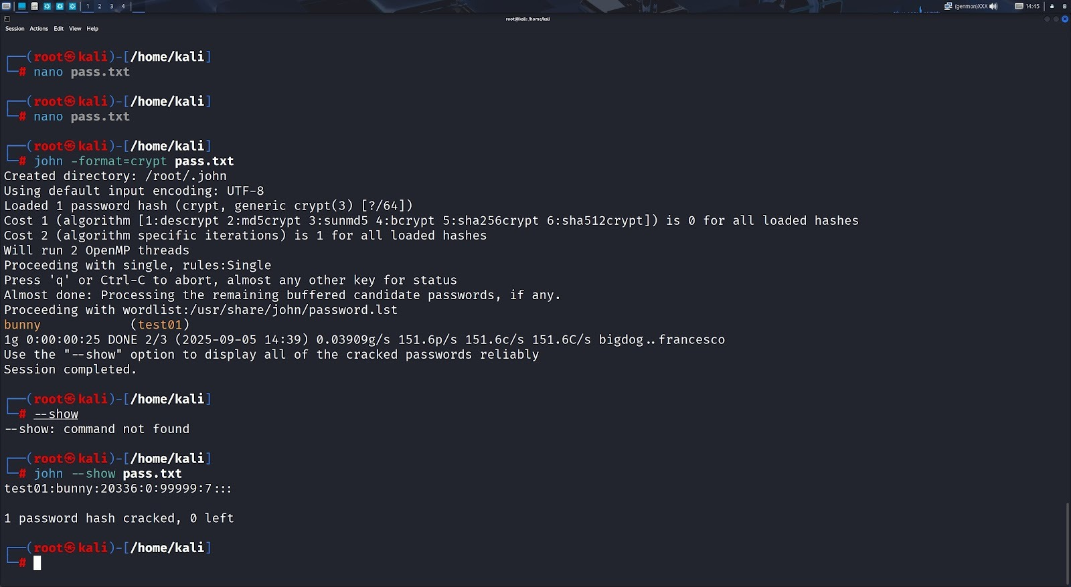
Execution → Give john -format=crypt pass.txt command to crack the password of the created user. It cracks the password when the password is in the wordlist file. → It cracks the password in seconds, Now the password cracking is completed. → For verification Purpose, use john --show pass.txt command , to verify whether the password is cracked or not.

Slide 20
Benefits of the Project
Practical Understanding: Direct exposure to ethical hacking tools.
Security Awareness: Learn how passwords are broken and how to prevent it.
Industry Skills: Gain experience using tools employed in penetration testing.
Career Prep: Useful for roles like Ethical Hacker, SOC Analyst, Pen Tester.

Slide 21
Deliverables
Password hash cracking demonstration using John the Ripper.
Documentation of tools used, commands executed, and outcomes.
Password policy analysis and recommendations.
Final project report and presentation.

Slide 22
Risks and Mitigation
Risk: Misuse of tool outside lab.
Mitigation: Supervised access, code of conduct.
Risk: Incomplete understanding of hash algorithms.
Mitigation: Include lecture/module on cryptographic hashing.
Risk: Tool compatibility issues.
Mitigation: Pre-configured virtual labs or Docker containers.

Slide 23
Budget/Resources Required
No financial budget required (tools are open-source)
Systems with minimum 8GB RAM
Internet access for downloading tools and wordlists
Virtual lab access (Kali Linux or similar environment)

Slide 24
Conclusion
This project will allow students to explore password security practically and ethically using a well-known tool like John the Ripper. By the end of this project, students will be able to audit password strength, understand attacker methodology, and recommend preventive measures to enhance organizational security.

Slide 25
Thank You

